Slide 1
CS 551
Spring 2025

Slide 2
What is Rust?
Systems programming language
You have full access to memory management
No garbage collector
You can get direct access to hardware
Statically typed
Compiler is super strict
Generally speaking, hard to write insecure code
Multi-paradigm
Functional, generics, concurrent, etc.

Slide 3
Why Rust vs. C/C++?
C/C++ are kind of a mess
There is a ton of technical baggage; C is from 1972!
Large chunk of material in this type of course could be weird C stuff
I’m not particularly interested in teaching you all these weird gotchas
No real build system
Lots of things that you have to keep in your head

Slide 4
What’s Rust’s downside?
C is a very simple language.
Rust is very much not a simple language.
C++ is kind of a nightmare in general.

Slide 5
Installation - rustup
https://www.rust-lang.org/learn/get-started
https://rust-lang.github.io/rustup/
curl --proto '=https' --tlsv1.2 -sSf https://sh.rustup.rs | sh
We are going to use the latest version (1.83 at time of writing)
If you want to pin a particular version:
rustup toolchain install 1.49
rustup default 1.49

Slide 6
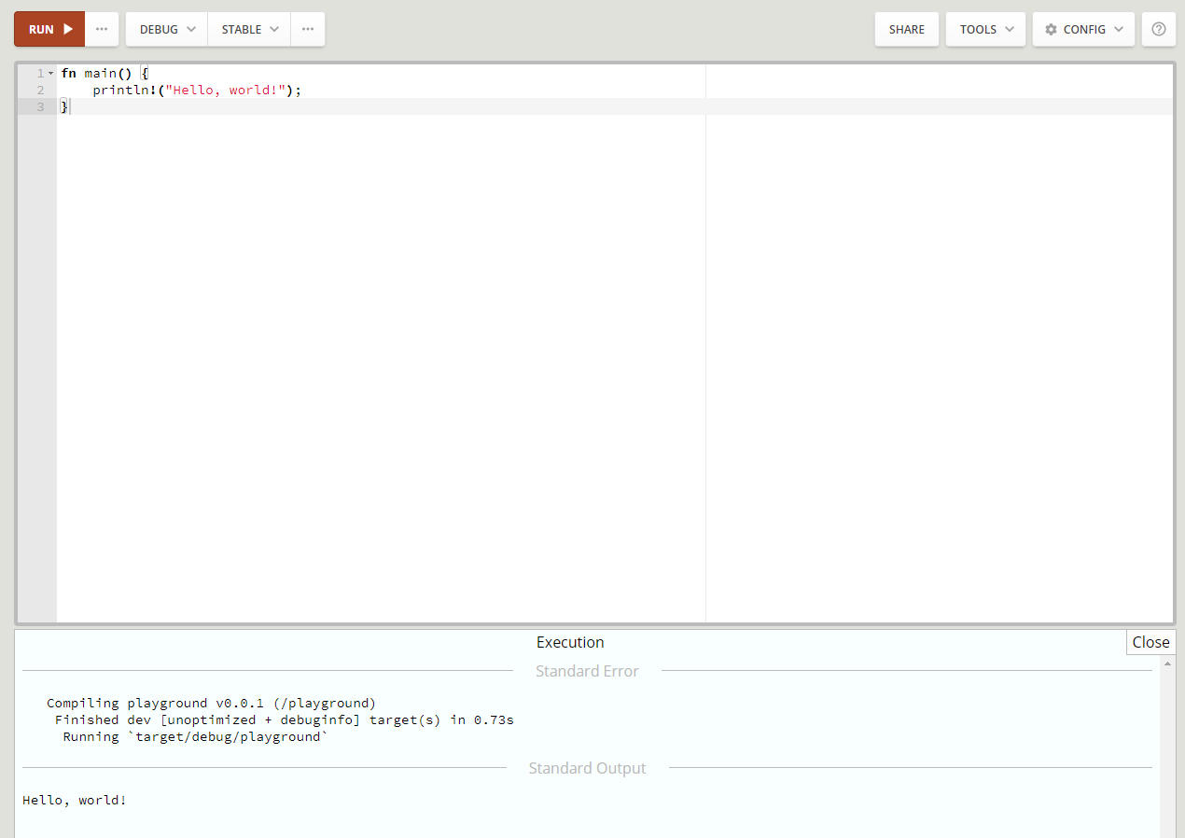
http://play.rust-lang.org

Slide 7
Rust has modern tooling
Makefiles suck
If you disagree with me, I’m sorry. You are wrong.
Modern languages have a legit build and dependency toolchain
Rust uses a system called cargo

Slide 8
cargo new <project-name>
Creates a new cargo project
There are lots of options
By default, new project will be in a directory called project-name
By default, new project will be set up to be a “binary (application)”
By default, new project will be set up to use git

Slide 9
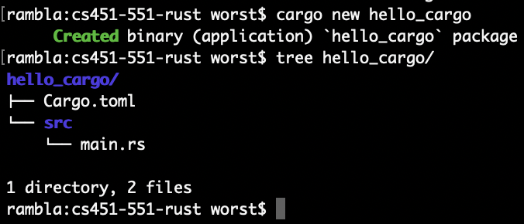
cargo new <project_name>
Creates a new cargo project
There are lots of options
By default, new project will be in a directory called project_name
By default, new project will be set up to be a “binary (application)”
By default, new project will be set up to use git

Slide 10
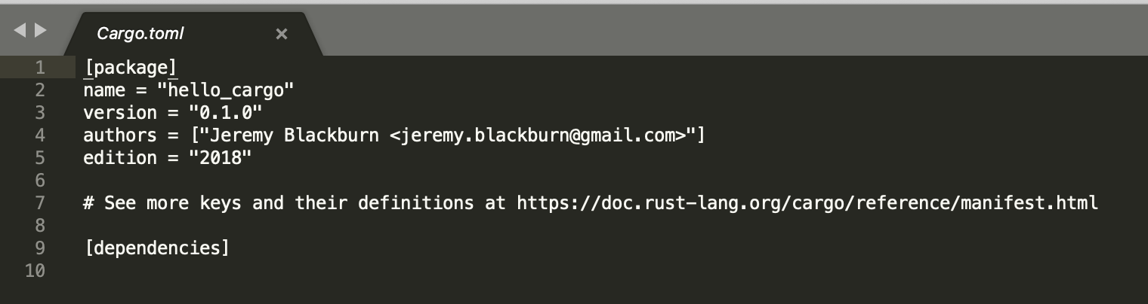
Cargo.toml
Configuration for project
Includes some meta data, as well as dependencies
We’ll come back to it later…

Slide 11
cargo run
Builds and executes your project

Slide 12
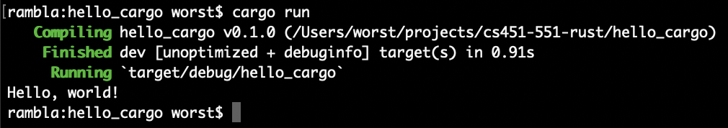
cargo run
Builds and executes your project

Slide 13
cargo build & cargo check
cargo build will build the project
Does not run it
Will fetch and build any dependencies as well
cargo check will check for errors, but does not actually generate any code
Faster than full build

Slide 14
Here we go…

Slide 15
Here we go…
We’re declaring a function called main

Slide 16
Here we go…
{ braces } enclose blocks of code (just like C)

Slide 17
Here we go…
We are going to call the printlin!() macro and print out a string

Slide 18
Here we go…
Statements end with a semi-colon

Slide 19
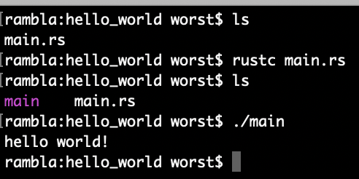
Here we go…

Slide 20
Here we go…
We put this code in a file “main.rs”

Slide 21
Here we go…
We compile it with the rustc compiler

Slide 22
Here we go…
It outputs an executable

Slide 23
Here we go…
And we can execute it

Slide 24
Here we go…
99.999999% of the time you will not be calling rustc directly, but will be using cargo!!!!!!
An we can execute it

Slide 25
Guessing Game
This is from the Rust Book
Shows some good concepts real fast
We want to have the computer pick a number, and then user take guesses until they get it right

Slide 26
How it will work
We want to ask the user to enter a number.
Read that number in from the user.
Compare to a secret number
Repeat until the user gets it right
Maybe we should give some hints along the way?

Slide 27
Let’s start

Slide 28
Let’s start
“let” statement creates a variable

Slide 29
Let’s start
mut means this will be a mutable variable

Slide 30
Mutable variable? What?!?
All variables in Rust are immutable by default
You cannot change their values once assigned!
The compiler enforces this!
It is thus impossible to change a value ”by accident”
If you need a mutable variable, you explicitly state it with the mut keyword

Slide 31
Let’s start
We will call this variable guess

Slide 32
Let’s start
We will bind guess to whatever value is on the right hand of the = sign

Slide 33
Let’s start
We are binding the return value of String::new() to guess

Slide 34
Let’s start
String::new() is a function that returns a new instance of a String

Slide 35
Let’s start
String is a type from the standard library, and new() is a function associated with the String type, which is indicated by the ::

Slide 36
Now we need to read something in!

Slide 37
Now we need to read something in!
SORRY ABOUT TYPO!

Slide 38
Now we need to read something in!
We can import functions from other name spaces.
Here we are bringing in IO stuff

Slide 39
Now we need to read something in!
We are going to read a line from stdin.

Slide 40
Now we need to read something in!
We need to pass in the variable we want to read into

Slide 41
Now we need to read something in!
Because we are going to be modifying the parameter we sent, we make sure we mark it as mut

Slide 42
Now we need to read something in!
The & indicates that we are passing guess in as a reference

Slide 43
Now we need to read something in!
A reference is kind of an immutable pointer. We’ll talk more later.

Slide 44
Now we need to read something in!
Here is where we handle errors that might have happened!

Slide 45
Now we need to read something in!
read_line() puts stuff in a passed in variable, but it also returns a Result type value!

Slide 46
Now we need to read something in!
Result is an enum, with possible variants of Ok and Err

Slide 47
Now we need to read something in!
An io::Result type has an expect() method that exits the program with a message if the Result is an Err

Slide 48
Now we need to read something in!
What kind of errors might happen when we are reading in from the console?
What if we don’t use the Result?

Slide 49
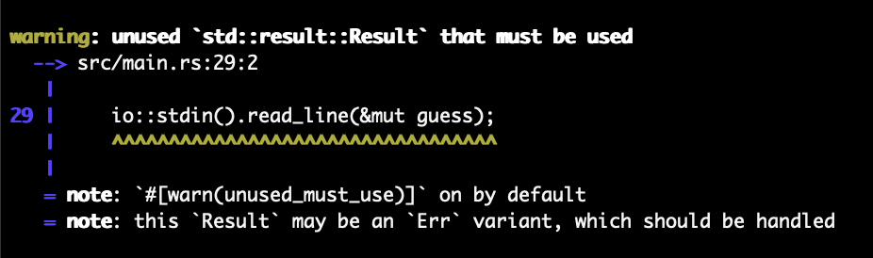
Now we need to read something in!

Slide 50
Bringing in a dependency
Let’s use an external dependency to generate random numbers
These external dependencies are called crates
We can set it up in our Cargo.toml
We can also use `cargo add`, but let’s do it by hand first

Slide 51
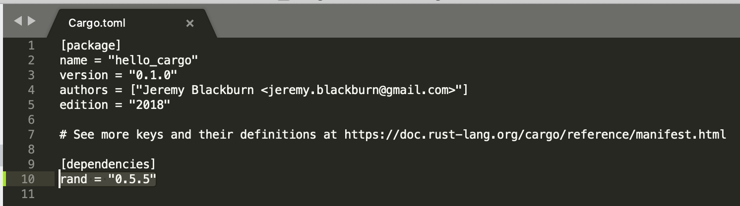
Bringing in a dependency
Let’s use an external dependency to generate random numbers
These external dependencies are called crates
We can set it up in our Cargo.toml

Slide 52
Bringing in a dependency
Let’s use an external dependency to generate random numbers
These external dependencies are called crates
We can set it up in our Cargo.toml
Cargo honors semantic versioning of dependencies.
That is a separate topic

Slide 53
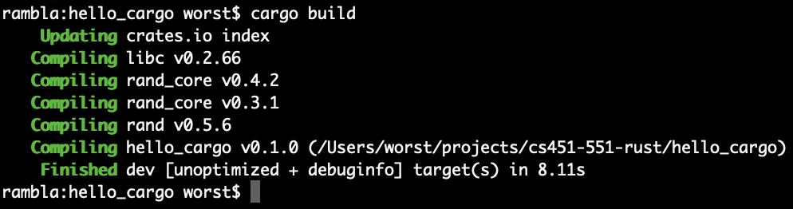
Bringing in a dependency
Let’s use an external dependency to generate random numbers
These external dependencies are called crates
We can set it up in our Cargo.toml

Slide 54
Using our dependency

Slide 55
Using our dependency
We need to use functionality from the dependency we just added.

Slide 56
Using our dependency
Here we are using the dependency we added to generate a random number
This is a typo! It should be (1..101);

Slide 57
Using our dependency
How do we know what functionality our dependencies provide?

Slide 58
Using our dependency
How do we know what functionality our dependencies provide?
cargo doc --open

Slide 59
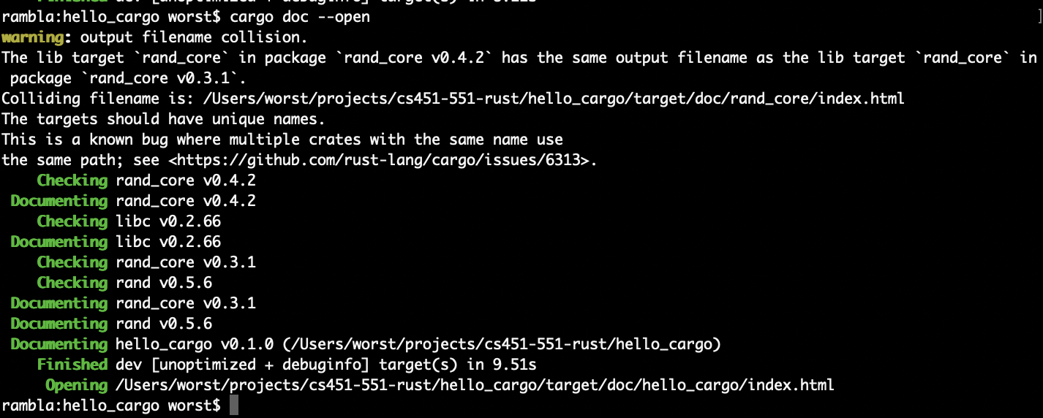
Using our dependency
How do we know what functionality our dependencies provide?
cargo doc --open

Slide 60
Using our dependency
Note that technically Rng is a trait. We’ll talk more about traits later (hopefully)

Slide 61
Using our dependency
Awesome. How do we compare things?

Slide 63
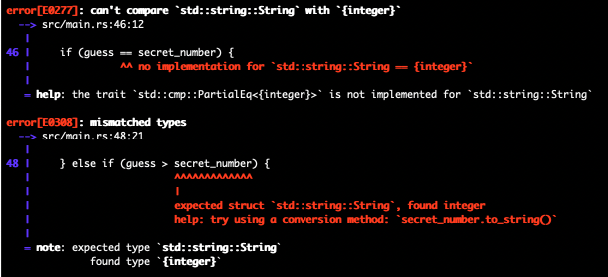

Slide 64
What? Where did all these types come from?

Slide 65
Rust has type inference
We’ll talk more about types later, but tl;dr: you can manually annotate types too
E.g., let x: i32 = 5;
Statically typed languages do not require you to manually annotate your types
C requires it (kinda?!?), but, that’s C, not static typing
With a few semi-exceptions, Rust is able to infer what types your variables are
let x = 5; // ok, x is a numeric value
let x = String::new(); // ok, x is a string because String::new() returns a string
But static type checking is still enforced at compile time!

Slide 66
Rust has type inference
Statically typed languages do not require you to manually annotate your types
C requires it, but, that’s C, not static typing
With a few semi-exceptions, Rust is able to infer what types your variables are
let x = 5; // ok, x is a numeric value
let x = String::new(); // ok, x is a string because String::new() returns a string
But static type checking is still enforced at compile time!

Slide 68
We can transform our String guess into an integer to compare to the secret number

Slide 69
We can transform our String guess into an integer to compare to the secret number
Note that parse() can error and thus returns a Result type!

Slide 70
Because we are using a new let expression, we are shadowing the previously defined guess that was a string!
We can transform our String guess into an integer to compare to the secret number
Note that parse() can error and thus returns a Result type!

Slide 71
Because we are using a new let expression, we are shadowing the previously defined guess that was a string!
We can transform our String guess into an integer to compare to the secret number
Note that parse() can error and thus returns a Result type!
We are manually annotating the new guess to be an i32, this allows additional type inferences to be made by compiler.
E.g., an i32 is an integer, and thus we should fail if our string is “3.14”

Slide 72
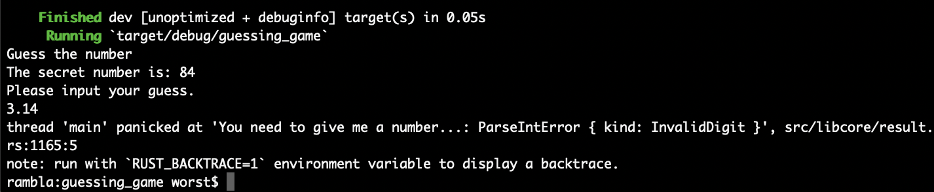
Because we are using a new let expression, we are shadowing the previously defined guess that was a string!
We can transform our String guess into an integer to compare to the secret number
Note that parse() can error and thus returns a Result type!
We are manually annotating the new guess to be an i32, this allows additional type inferences to be made by compiler.
E.g., an i32 is an integer, and thus we should fail if our string is “3.14”

Slide 73
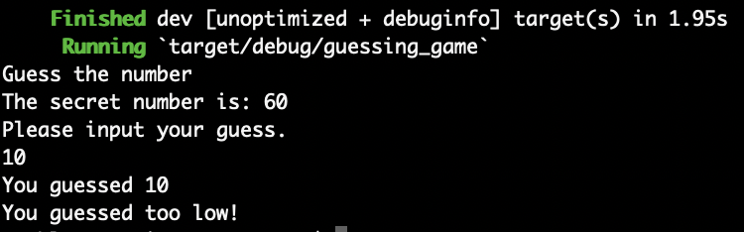
Because we are using a new let expression, we are shadowing the previously defined guess that was a string!
We can transform our String guess into an integer to compare to the secret number
Note that parse() can error and thus returns a Result type!
We are manually annotating the new guess to be an i32, this allows additional type inferences to be made by compiler.
E.g., an i32 is an integer, and thus we should fail if our string is “3.14”

Slide 74
Environment setup and docs
Rust has really good tooling
That tooling allows some pretty good IDE integrations
I use VS Code
Rust-analyzer
clippy
READ THE DOCS
READ THE DOCS
READ THE DOCS
READ THE DOCS

